Slide 1
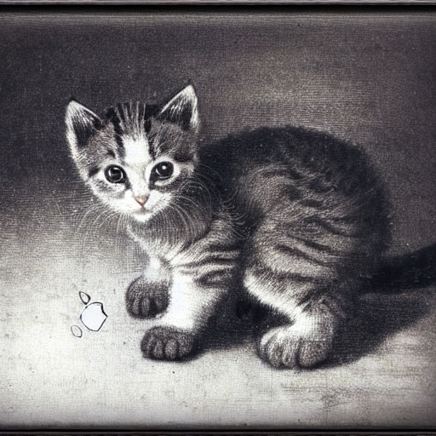
You're probably wondering why I'm here.
And so am I.
A kitten using a Macbook Pro in the style of Rembrandt
Miikkali Leppihalme, 25. May 2023
Notes:
Hi, my name is Miikkali. The long-time members of this community know me as the guy from The University of the Arts Helsinki, where I was the lone Mac admin from 2015 to June last year. You might be wondering why I'm still here. I hope we have new folks in the audience, too. If you don't know me from before, come and say hi on a break after the presentations. I like meeting new people.

Slide 2
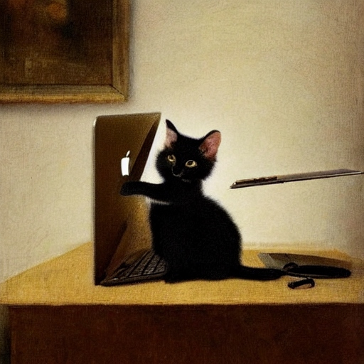
Introduction
A kitten using a Macbook Pro in the style of Rembrandt
I just speak. Old-school.
My bullet points are pointless.
Images created with DeepAI text2img.
Personal opinions, not my employer's.
Notes:
I nowadays work in cybersecurity at Nixu, but I'm presenting here on my own behalf. These are my personal thoughts.
I still feel like a Mac admin at heart, it hasn't left me completely. I've been interested in cybersecurity before that word existed. I'm 50 years old and I wrote my first article for a computer magazine about computer viruses when I was 15. I'm not bragging. That's just for perspective and to give a reason why I switched to cybersec. Long-time interest.
How was I able to make the jump? I have no education in the field. To put it short, I just started leaning toward cybersec little by little. I thought that eventually it's not what you are, it's what you don't become that hurts.
If you're interested in the how - listen. For the ones expecting some technical stuff, I will also briefly explain methods of persistence on macOS. If you're just starting your path as a Mac admin, you'll find it interesting.
I will also have some straight words about admin privileges on macOS. If still not interested, there will be cat pictures for entertainment, so you can also just pretend you're listening. If you hate cats, too, you can already walk out. Have a break with your fellow cat haters.
The images in my presentation are created using the DeepAI text-to-image tool. This picture is "A kitten using a Macbook Pro in the style of Rembrandt". My speech is self-generated from the top of my hat.

Slide 3
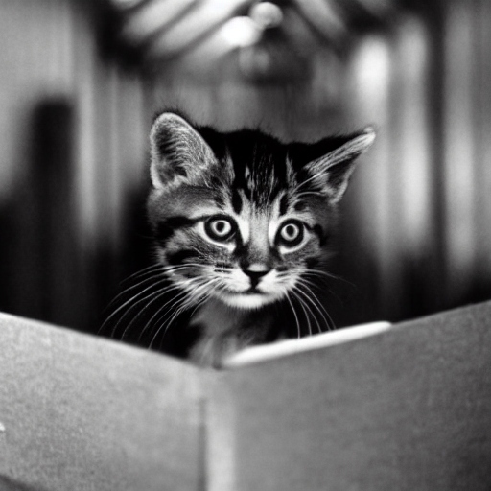
GDPR
A kitten dealing with data security regulations in the style of Dennis Hopper
Communication skills are essential.
DeepAI doesn't really grasp Dennis Hopper's style.
Notes:
I was a Mac admin in charge of a fleet of about 500 Macs. When GDPR was enforced in the EU, four years ago to the day, it caused a lot of fuss. My workplace was a drowsy little university, nice and stagnant. Until GDPR, our CIO had taken care of the information security issues, but enforcing GDPR was a lot of work, so we hired a security officer.
The new security officer was great. He was friendly, he told me he's coming from the Windows world, and never used a Mac, but since he was given the option to choose his work laptop, he opted for a Mac, just because he wanted to try and explore.
I like that attitude.

Slide 4
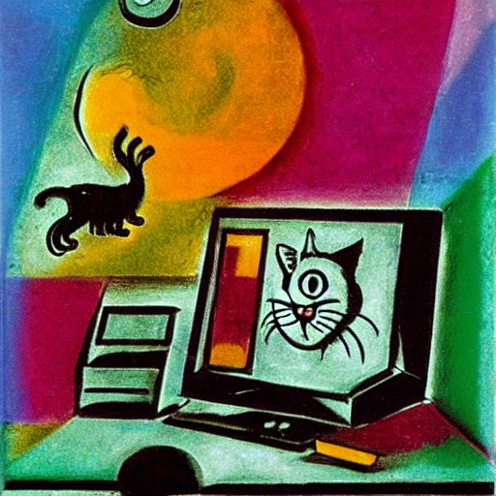
The Security Person
A kitten playing with an early Macintosh computer in the style of Marc Chagall
Making friends.
Encryption fun.
DeepAI knows Chagall's colors but otherwise just hallucinates, like me.
Notes:
I introduced myself as the Mac specialist and told him he can contact me directly with any issues with his Mac. Special service for the security person. Sure, I was bypassing the normal Service Desk ticketing, but for a good reason, because I thought that it would be pretty risky if our new security officer fumbled with an operating system that he'd never worked with. He deserved a shortcut. And our helpdesk would anyway forward the tickets to me. So we did.
It was great fun trying to get PGP encryption working with his email. Not really. It was not fun and never worked. I guess that's a platform-independent issue, not particular to macOS. PGP is a nice idea, but you just can't get it to work all the time every time with everyone. There's more to say about email encryption issues with Macs, but I'll leave you waiting. When you hear me say S/MIME on Outlook for Mac, you can expect to hear a stupid fact that can make you both laugh and cry.

Slide 5
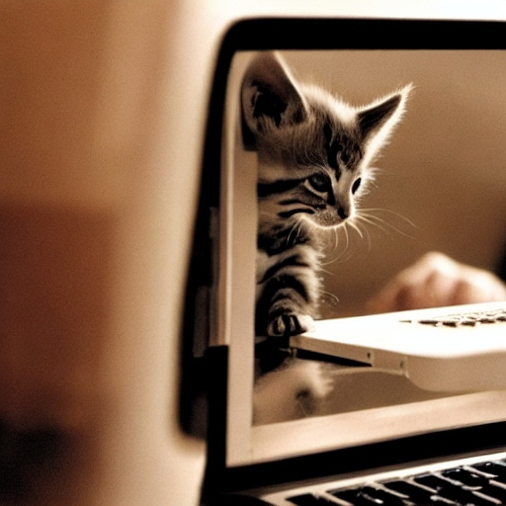
Collaboration
A kitten using an Apple computer in the style of Dennis Hopper
Good things happen in a worrisome atmosphere.
That's me in the corner.
In the spotlight.
Losing my religion.
Notes:
To continue my story, during the following weeks and months, I received many security-related questions from our new security officer about macOS.
Working with his questions helped me to understand the user-facing issues better. That was great. I was able to enhance our management workflows efficiently. I was also able to learn about data security and privacy issues from his point of view, which at that point was on complying with laws and regulations.
When I sent him answers and links to Apple's documents, he also studied them. I mean he really did! After a while, he was convinced that macOS indeed is different from other popular operating systems, especially in system security and user data security. Sure, it's a UNIX-compliant system, one of the few, as per the Single UNIX Specification, but it's a different beast when you try to manage it in a centralized manner, especially with anything dealing with security or privacy. Which is, by the way, a good thing.

Slide 6
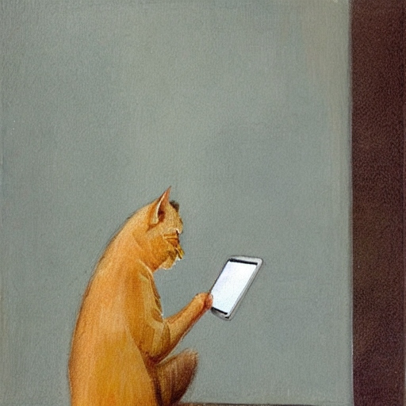
The Security Landscape
A cat fondling an iPad in the style of Helene Schjerfbeck
The same, but a new kind of same.
A shift of angle and focus.
The cat looks like it's the last day to file the tax report and the authentication page just gives a blank screen on iPadOS.
Notes:
We managed to comply with GDPR in due time - but then it was not just about new regulations and complying with the law.
In a few years, the whole security landscape had changed for workstations, too. We had more concerns with Mac-related security compromises. The old mantra about Macs having no viruses was obsolete, irrelevant.
We didn't know shit about threat modeling and the management was like "hey, let's just put Microsoft Defender on all machines and be done with it, all good". They didn't think much further than that.
I thought I needed to explore and be able to explain the methods to gain persistence on macOS to myself and to the managers. I started looking at my everyday tools like AutoPkg and Munki or any centralized management system as an attack vector. I needed to know which settings in macOS can be enforced and by which methods. What can be done silently and what not? And how much the end user would have a say in that. And can there be a man-in-the-middle there? I spent a lot of time looking for possibilities to compromise macOS in our environment.
Originally, we had machine certs on each Mac, which was kind of overkill, because Basic HTTP authentication over TLS/SSL would have been quite enough, but I didn't have anyone to tell me the requirements, so I built it to the highest standards. Got my ass covered.
Next, something about methods of persistence on macOS, thoughts on admin privileges for end-users, and a mix of short notes that I think are important today.

Slide 7
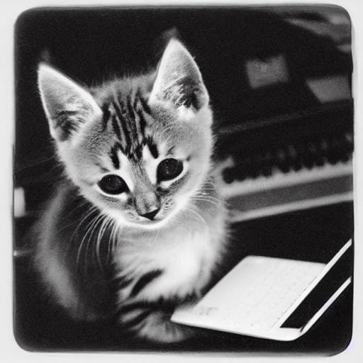
User and admin contexts
A kitten using a Macbook in the style of Sally Mann
What does root mean, anyway?
Picking a fight. Just wait.
Doesn't look like a Sally Mann photograph. DeepAI is really just a toy.
Notes:
It's vital for any workstation admin to understand the difference between the user context and the root context. You run scripts, you deploy configurations, which context? What's the effective difference? Other than that some actions require root. A thing to remember is that root has no knowledge of the logged-in user let alone their PATH variables. Build your script well. And scope them.
Also, on macOS, the root context is different from root on Windows or Linux, or just about any other system.
On macOS, today I see no reason to restrict the user to standard privileges. Ok, there are some heavily restricted environments, but I'm talking about a regular company or educational institution. The big mass.
If you think alike and are a Mac admin and you want to talk about this with your security team, and most often the security team doesn't understand macOS, it can be hard, I feel for you, but you could find ways to communicate. Be friendly even when frustrated. Ask if the Finnish Apple folks could help. They've offered training and Q&A sessions in the past. You just need to ask.

Slide 8
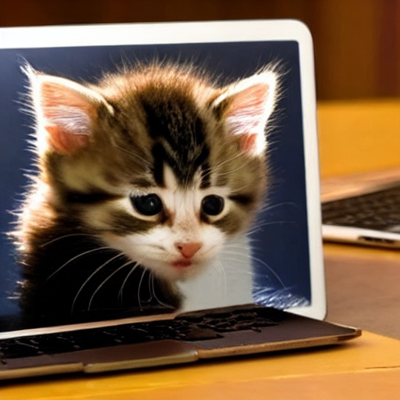
What can we enforce and what not?
A kitten using a Macbook in the style of Dennis Hopper
You can't do anything without a Mobile Device Management system.
With MDM, you rule, but not everything.
When you tell DeepAI to do something in Dennis Hopper's style, you always get a grave look in the distance. It seems DeepAI is trained with just one or two images of Hopper's work.
Notes:
The principal method of managing configurations on macOS is Configuration Profiles. You can deploy them only through an MDM system. The only other way to install a profile is manually by the user through the GUI.
There's a fairly large set of configurations we can manage and deploy silently. Then there are some things that always need user consent. There are also enforceable things that users can't change, even if they're admin users. If there are contradictory profile settings, the MDM-deployed profile wins.
That sounds pretty straightforward to me. Some admins have still grieved that we can't completely own the users' configurations as we used to. Like allowing the camera and the mic. It used to be so easy! Yeah. It used to be easier to spy on users and do things behind their backs. The restrictions have recently centered on privacy. That's something the user should have a say on. Not us admins.

Slide 9
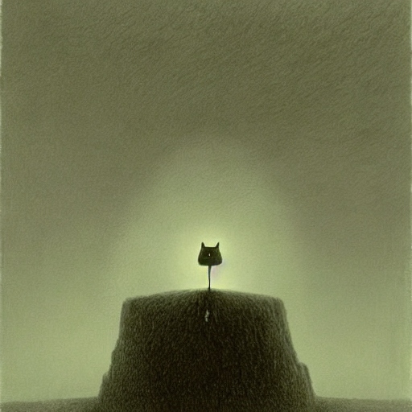
Complaining Feedback
A troubled cat with an Apple device in the style of Zdzisław Beksiński
Send feedback to Apple.
Don't expect a direct response, but keep doing it.
Notes:
You can complain, but it's not a productive use of your time to fight against Apple. File feedback, sure. It helps a lot if your issue has an impact concerning a hundred thousand Macs, but if your fleet is small, you'd better gather your friends behind you and everyone file duplicates on your feedback tickets. Good luck! I'm not saying that Apple doesn't listen. They do. They just might not respond.
About the macOS security developments during recent years, generally, can you think of a single bad thing about System Integrity Protection or the Signed System Volume? Or the Secure Enclave? I can't. And it doesn't matter if we did, because there's no option, it's the nature of the system now. And that's good! Your Windows-minded security team might not understand all this yet. Again, if you need help in explaining macOS security fundamentals, nudge the Apple folks here at the meeting and ask if they can help.

Slide 10
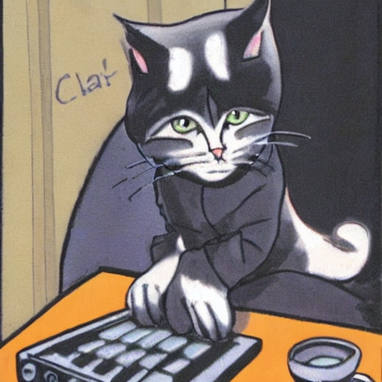
An old SIP story
A cat demon with a computer
Working with artists, don't assume anything.
Working with anyone else, assume they're artists.
Notes:
Hey, I have a nice story about System Integrity Protection. I remember it as the first system-wide security improvement that affected admins and centralized management attempts all over the world. Everyone was asking "Where can we write to anymore?"
SIP prevents anyone, even an admin user, from writing to a set of crucial system folders in the file system. It's a simple and clever design to tamper-proof the system. It also requires a bit of learning and conscious effort to turn it off. You can learn it in three minutes on YouTube, but it doesn't turn off by itself or by accident. And every Mac admin monitors their fleet's compliance and raises a red flag if a Mac has SIP disabled, right?
Right, one day I saw that one of our user's Macs had SIP disabled. I thought it was some weird macOS upgrade anomaly, or maybe my reporting system was broken. This was the University of the Arts, and it was unimaginable for me that any of these artists, teachers, researchers, or office workers would have an actual need to turn off SIP. I sent an email to the user.
He replied that he was doing his doctoral thesis. He was inventing and developing an audio signal processing language and he needed to do kernel coding. Wow. Those artist folks never failed to amaze me.

Slide 11
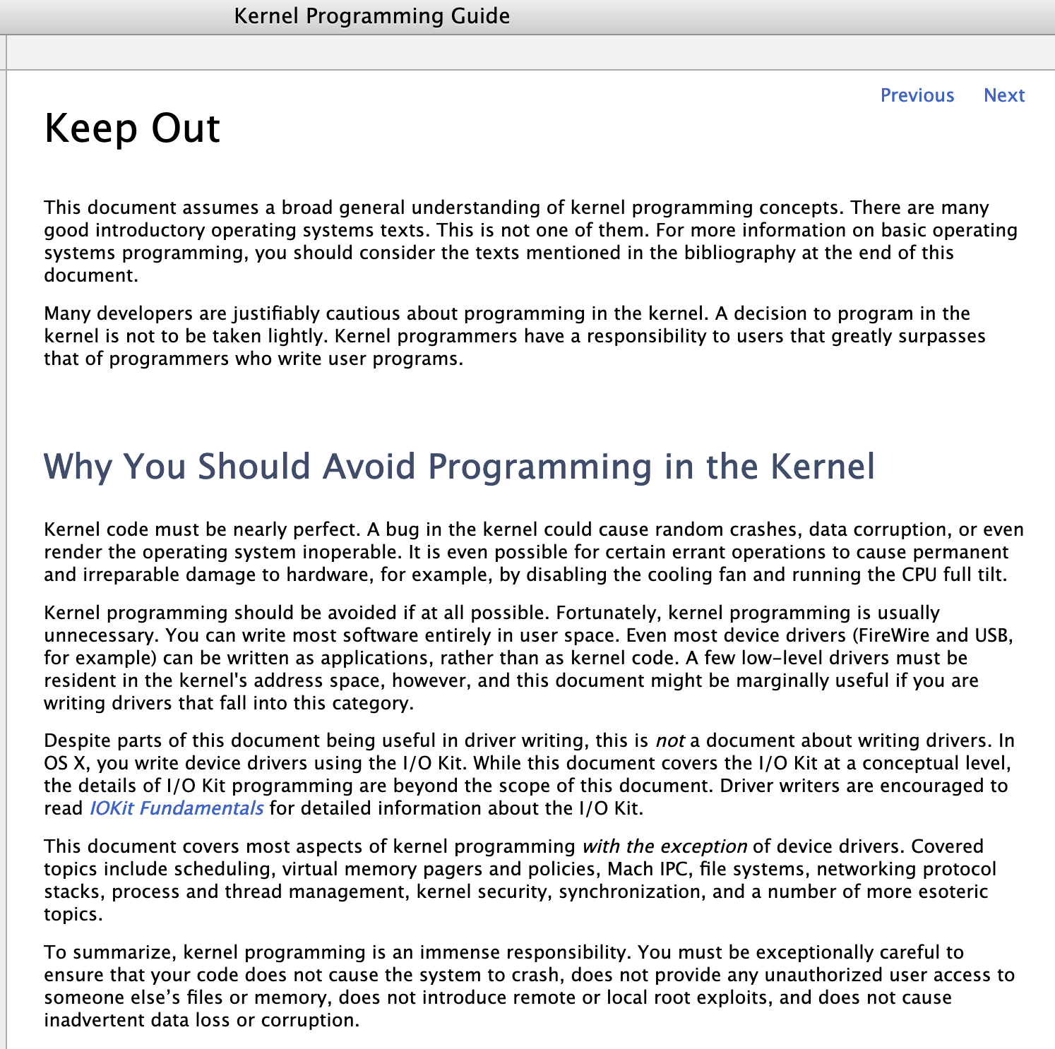
Keep Out
Kernel code must be nearly perfect
https://developer.apple.com/library/content/documentation/Darwin/Conceptual/KernelProgramming/keepout/keepout.html
Notes:
Apple's Kernel Programming Guide is available in Apple's archives, it's titled "Keep out" and says that "Kernel programming is a black art that should be avoided if at all possible." So, I had a cool edge case for a user. He convinced me that he stores no personal data on the Mac. He doesn't log in to any of our services. It's purely a development machine and a test bench for technical work on his doctoral thesis. We let it be.
Of course, nowadays, there's no more kernel extension coding like that. Apple has since created new APIs to fondle the kernel more securely, without fucking up and crashing the system. Since that, it's been an effort for all security software vendors to update their software to use the new way, namely System Extensions, and Network Extensions.

Slide 12
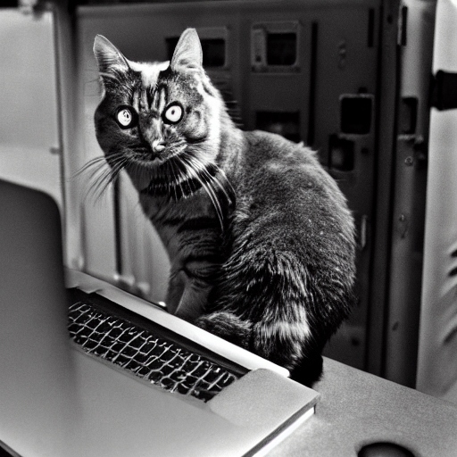
Methods of persistence
A cybersecurity cat with a Macbook inspecting servers in the style of Ansel Adams
launchd.info
https://objective-see.org/tools.html
DeepAI is on a bad trip. There's no resemblance to Anselm Adams' work whatsoever. Nice keyboard, looks like mine.
Notes:
If you're a new Mac admin just starting on your path, this is a quick primer. If you have years under your belt, go grab a coffee.
LaunchAgents and LaunchDaemons are scheduled background jobs.
If you come from the Unix world, this is like cron but better. More versatile, easy-to-read config files in simple XML. Cron exists on macOS, too, but it's rarely used, which makes it an interesting option where to hide malicious executions.
launchd.info is a very good source when you want to understand how these jobs are controlled on macOS.
LaunchAgents run on the user level, so they affect only the logged-in user. They need only the user's permission to run. User-level settings are tough to administrate as all the management tools run as root. Also, there's rarely a good reason for messing with user-specific settings. Normally we manage system-wide settings that affect all users.
macOS has decent built-in methods to prevent stupid things from happening, but sure, if a malicious actor convinces the user to click yes yes yes, and install an evil LaunchAgent, user data can be compromised, and that might include company data and secrets.
In that kind of a situation, it doesn't much matter if the user is an admin user or a standard user.
A LaunchAgent still can't corrupt macOS, the system. The system volume is untouchable. That's why it's called the Signed System Volume. It's completely separate from any user data. The user can't write to it. Only Apple can. Every system update is verified online with Apple and signed by Apple during the update or upgrade process, so installing macOS requires a live Internet connection, even if you have an installer on an external drive and want to do it offline.
This makes updating Macs in an air-gapped environment with no internet connection using only file-based transfers quite impossible. I don't know if anybody really uses Macs in those sorts of top-security environments. Just a thought. Something I need to consider in my current job.
Another thing on the user level is Login Items, visible in System Settings. They're apps that are launched at login. New in macOS Ventura, Login Items also shows LaunchAgents and LaunchDaemons. If you're running an older macOS, which you shouldn't, there's a great third-party tool, KnockKnock, from Objective-See. I recommend it even if you're running Ventura because it shows much more than just the daemons, agents, and Login Item apps. It has browser extensions, cron jobs, Kernel and System Extensions, startup scripts, and more.
The developer, Patrick Wardle, has created many nifty end-user security tools. I recommend checking them out if you already haven't. They're all free. Mr. Wardle also hosts a library of malware samples, if you need to explore. Take care. <https://objective-see.org/tools.html >

Slide 13
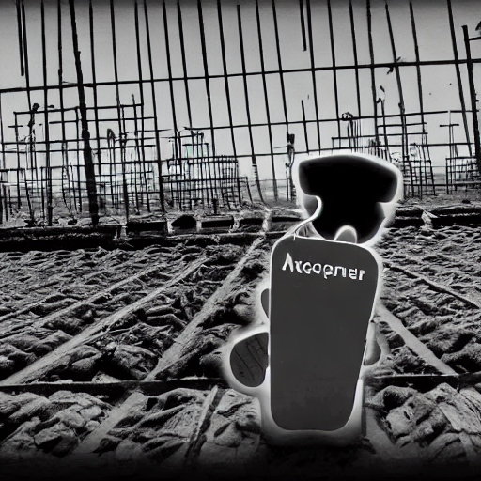
More methods of persistence
A cybersecurity cat with an iPhone inspecting servers in the style of Ansel Adams
You're not a sysadmin if you don't have a family of daemons.
DeepAI is great if you've had multiple beers and don't expect much.
Notes:
LaunchDaemons are powerful, as they work on the system level. They run as root. Centralized installation and patch management systems, plus local app updaters and other "helper tools", depend on LaunchDaemons, and so do all security software. You need admin privileges to install a daemon. So, while you can install apps as a standard user, many apps have an updater app that will require admin privileges.
Great opportunities for a malicious actor, right? Nice opportunity for a supply chain attack. Tap into the feed, and pour your poison where the legitimate updates happen. Sure, that has happened and probably will happen again, so evaluate carefully which update feeds you are willing to trust.
If you're running on-premises, the onus is on you to secure your management systems. How strongly, depends on your threat models. That's not a Mac thing anymore. Just the other admin work that often comes with being a Mac admin. You need to work with other teams and often educate them on macOS peculiarities.

Slide 14

Configuration Profiles
A worried cat with an iPad Pro in the style of Edvard Munch
Not much worth trying to hack.
If you're evil, try something else.
Notes:
Configuration profiles may sound great to a young criminal mind, but profiles can only be deployed through an MDM system. This method doesn't really work unless the evil criminal can break into your MDM, which is when you'd have even bigger problems. If you're running your MDM on-premises, take care. If not, take care, anyway.
Let's say a bad person hasn't completely owned your MDM, but they are able to sneak in a configuration profile and deploy it to your Macs. That still takes a non-trivial amount of knowledge to do that profile installation silently, if it deals with privacy or security settings. And you can't hide a profile from showing up in the end-user's System Settings.

Slide 15
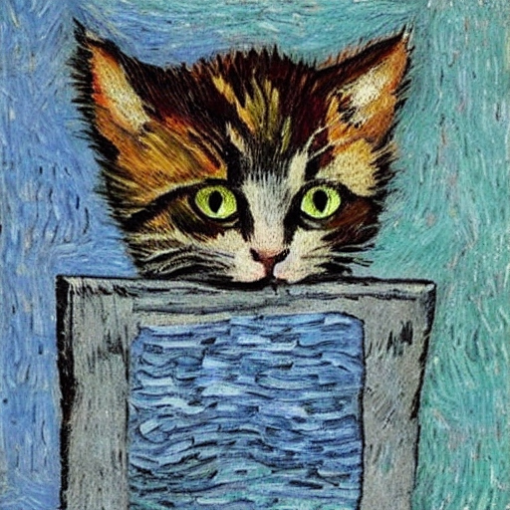
The private parts
A kitten hiding her private parts in the style of Van Gogh
No camera
No mic
You can allow a standard cat to allow a thing or two to be allowed for an app to do, which sounds silly but is actually sane.
Notes:
Some privacy settings, like Screen Recording or using the Microphone, can't be pre-allowed by management systems. It always needs the end-user's consent. That's the popup you see when "Teams would like to use your camera. Allow?" The admin can't allow that on the user's behalf. It's also something a standard user can't do. With a configuration profile deployed through your MDM, you can allow to allow the standard user to allow Teams to use the camera or the mic by telling macOS that apps marked with Microsoft's TeamID are legit. Simple, isn't it?
Many Mac admins would love to have more control over silent installs and silent configurations, but Apple is pretty strict on user consent in privacy and security matters. Apple sees no contradiction, as they have designed the system so that the user is by default an admin user. We might have different needs in enterprise or education, but Apple is a consumer electronics and services company.
If you're unhappy, send feedback to Apple. If you have an Apple ID and have registered for Appleseed, send your feedback through that channel. I have a hunch that you'll get more attention than with basic user feedback. Maybe even better if you have an Applecare for Enterprise agreement.

Slide 16

Clever tricks and stupid actions
Cats with Apple computers in the style of Vasili Kandinsky
Where are the threats?
Notes:
So, with macOS being so super secure, and your network and authentication being strong, and as you're patching all the software all the time, what's a poor malicious actor to do? Very little, right? Maybe not. Tricking the user to do stupid things always works for something. If the user is an admin and has access to restricted resources, the attacker would try to move laterally, and whatever, and disaster follows, but that's not a thing specific to Macs either. Doesn't matter if the user is standard or admin.
I think today the worst threats are ransomware and data theft, often through social engineering. Server misconfiguration by human error leaving databases open for theft seems to be popular. You don't need a clever attack or much lock-picking if the door is open. They're not Mac-specific threats at all.

Slide 17
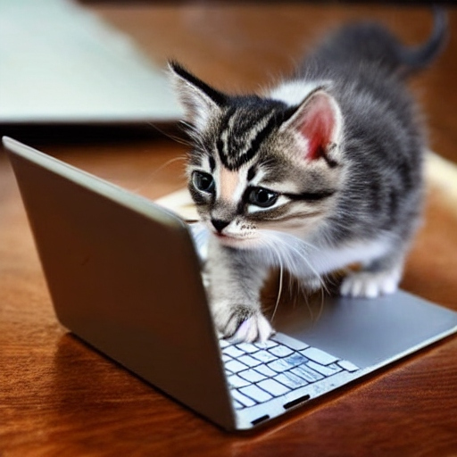
Zero Trust
A kitten using a Macbook in the style of Reidar Särestöniemi
I don't trust you.
You don't trust me.
I don't trust me.
I don't trust DeepAI to know anything about Reidar Särestöniemi.
Notes:
Just a quick note on the subject of the Zero Trust concept.
You trust me on some level, right? You wouldn't be listening to me if you didn't. Ask me a specific thing and I will send you a script that will supposedly help you in your task, and because you think you can trust me, you will not read the script but blindly run it, and then I own your machine. Can I trust myself or my user account not to do something evil? I shouldn't.
It's better when I don't trust you, you don't trust me, and I don't trust me. That's one way to define the concept of Zero Trust. Mark McCullough (@TheHat) coined it.

Slide 18
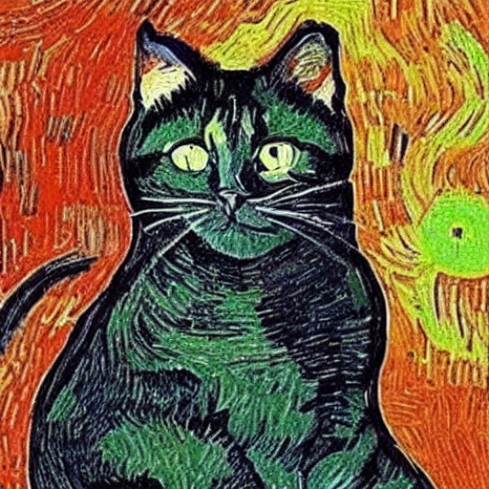
Admin privileges for users
Microsoft Windows cat in the style of Van Gogh
"If you’re more comfortable with the more restricted privileges of a normal user account, then why not use one? But don’t think it’s going to improve security or privacy."
https://eclecticlight.co/2023/01/24/is-it-more-secure-to-be-a-normal-or-admin-user/
Notes:
This is a controversial subject. Is it safe and secure to grant admin privileges to macOS users?
I'm going to quote Howard Oakley, a well-known and respected Mac admin. You should read this article. I don't have much to add. I just completely agree with him:
"If you’re more comfortable with the more restricted privileges of a normal user account, then why not use one? But don’t think it’s going to improve security or privacy."
https://eclecticlight.co/2023/01/24/is-it-more-secure-to-be-a-normal-or-admin-user/
And I'm adding to his sentence: As an admin, are you comfortable with administering all the things you need to administer when your users are standard users instead of admins? Knowing the burden that comes with it? If it was purely your decision? Do you know your users?
Sure, the question usually isn't about you being comfortable. If you're lucky, you might be able to change your organization's local policies but to do it, you need to be able to explain why would you do such a thing. And you need to explain it to Windows people.
Let's say you work in a big company with little understanding of Macs and you're the only person who does. Then you have a CISO from the Microsoft world and you have a Security Team, that administers mostly Windows and Linux infra, never used a Mac. They will still be telling you what "admin rights" mean on macOS as if they understood anything about it. Keep your head up high!
One more thing. If your users are standard users, and if your helpdesk is burdened with trivial tasks because users need to do things that require admin, I often hear recommended to deploy the open source tool Privileges created by SAP, which enables your organization to have your Mac users as standard users but let them elevate their privileges to admin for a period of time, like 15 minutes, so they can get some software install or whatever done. The app then records what happened and can send it to a server for logging, then demotes the user back to standard, so there's an audit trail of who elevated their privileges and when.
The Privileges app is used in many organizations, but I don't favor this approach. I don't trust you - or me. There's no such thing as temporary admin rights. You grant the rights for a moment, and a malicious user can gain persistence. Your "15 minutes" doesn't mean a thing. It goes down the drain. And while your audit trail is there, you've already shat your pants.
I haven't made up my mind completely, and usually, once I make up my mind, I'm full of indecision.
I know the lead developer of Privileges app, Rich Trouton, he's a smarter and more experienced admin than me, and if this process is ok with a huge company like SAP, I feel I'm crushing under their weight with my opinions, but apparently, I just can't shut up.

Slide 19
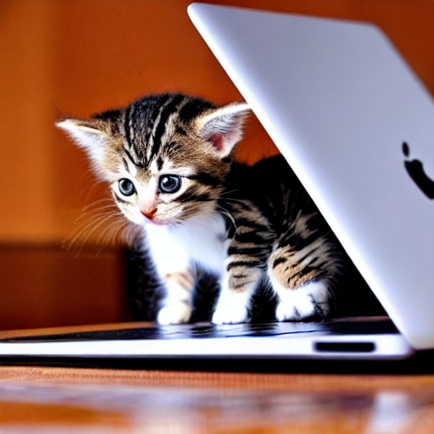
S/MIME and Outlook on Mac
A kitten using a Macbook in the style of Magdalena Rădulescu
Ed25519 keys not accepted.
Microsoft, c'mon. Like you never studied cryptography.
DeepAI, c'mon. Like you never studied Polish art.
Notes:
I promised you a fun and stupid fact about S/MIME and Outlook on Mac. Here it is. If you create an Ed25519 encrypted key, Outlook refuses to use it, because it's too short.
Let that sink in.
The whole point of Ed25519 is to provide a key that's both shorter and more secure than much longer RSA keys, so it's super efficient. I'm not saying RSA keys are bad, not at all, they're good, but Microsoft seems to have missed the memo on Ed25519. It's just stupid. Those keys are short by design! And maybe even more secure than RSA keys.
If you can find a way to get Outlook for Mac and S/MIME working with Ed25519 encryption, please, let me know. Not a biggie. Just a nerdy obsession.

Slide 20
New tools
I ran out of pictures so I'm reusing this one
Binary debugging tool: https://www.mothersruin.com/software/Archaeology/
Research tool: https://redcanary.com/mac-threat-analysis-tool/
Notes:
I left my Mac admin job last year, so I might not be in the loop with all the advancements, but I take note when a new security tool appears.
If you want to dig deeply into binaries, Archaeology is an interesting tool. It's meant for debugging, you might not need it, but I thought I'd mention it. It's a free tool.
https://www.mothersruin.com/software/Archaeology/
A security company called Red Canary recently released a tool called Mac Monitor. In their words, it's "designed to take advantage of the Endpoint Security API to monitor and ingest process and event data that other tools are skipping." It's mostly a research tool, but someone here might be interested, too.
https://redcanary.com/mac-threat-analysis-tool/

Slide 21
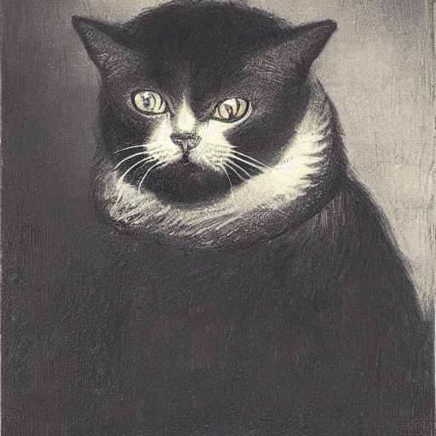
New work
A security specialist in a turbulent mood, as a cat, in the style of Rembrandt
How I am today.
DeepAI got it right this time.
Notes:
After leaving Uniarts and beginning my career in cybersec, many old Mac admin friends have asked if I still get to do Mac stuff or if the new work is completely different. I can't tell you any specifics of my work, but I can tell you about some encounters with humans. I like speaking about dealing with humans, and now that Robin Lauren is no longer with us, I feel even more obliged to hold the humanist flag.
After a couple of months in my new work, I had enough courage to criticize our Mac deployment process. I thought the workflow was clunky and incomplete. I also noticed little things that could be easily switched on to gain more security with no adverse effects on usability. I was invited to a meeting with the IT admins. I offered my views on management and security hardening. They were courteous, even nice, which was a pleasant surprise, and they actually did some changes. If you're going to a meeting where your job is to point out someone else's faults, be very polite, choose your words carefully, and you get better results than with finger-pointing.
Another time I helped them to find the reason why and how a Microsoft Defender update had broken the app on some Macs. They don't use MacAdmins Slack at all, a small wonder. How can you know anything today without that resource? I found the answer there quickly.
Our customers are usually large enterprises that don't use Macs, at least not enough to warrant paying for a top-notch cybersec company for services. There's one customer. They want to check the security level and harden their Macs. It's quite a large company. They have about 50 Macs. They couldn't even ask the right questions. They were looking through Windows and Linux glasses. Which is kind of great, because it means more work for me. Happy to help.
The funniest moment for me was when I drifted into a debate with our Lead Architect in Microsoft technologies. It was great. It was just like you think it would be when you're the Mac specialist and you're talking with a senior Windows specialist who thinks Macs are just the same. The subject was admin privileges, as you would guess. He seemed to refuse to believe that on macOS it's a different thing in nature than on Windows or Linux. The debate was never resolved. He just stopped responding to me. It's not a big issue for me, but I get a bit annoyed when someone just walks away from a debate. Sometimes it happens.
If you drive for changes, be prepared for resistance and misunderstandings. Have a collection of reference documents ready. Be friendly and polite. Sometimes it leads to better things for all. Not always, so also take care to pick only the fights where you have a chance of winning.

Slide 22
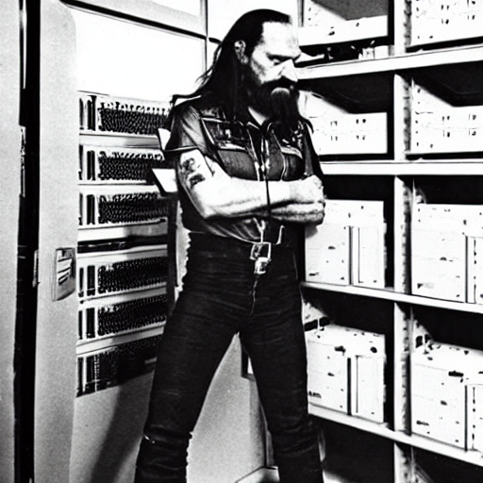
To conclude
Lemmy Kilmister inspecting a server room in Dennis Hopper's style
I will always love you.
I still accept free beers.
Notes:
I've been circling around my transformation from a Mac admin to my current cybersec job. My moment of decision was one year ago in this FinMacAdmin meeting when Antti Pettinen was on stage presenting and then he announced that Nixu is hiring. I thought I'd try my wings, and I've flown reasonably well this far. As I said, I'm not representing Nixu here, but I should mention that we're hiring. Come and say hello.
I haven't forgotten my background and my personal interest in Macs. I'm still using every opportunity to help folks struggling with their Mac issues. It's hard to abandon something I did for a decade, got pretty good at, and still like.
There's always a special place in my heart for this community. I wouldn't have flown this far without you.

Slide 23
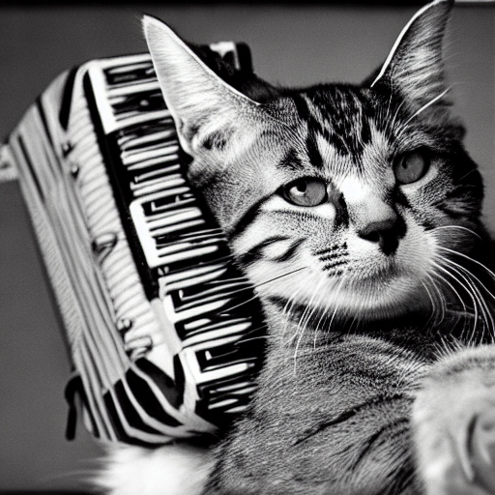
Thanks for listening!
A cat with an accordion film camera, in the style of Dennis Hopper
@miikkali - MacAdmins Slack
miikkali@gmail.com
Why did I prompt DeepAI with that?
Notes:
Thanks for listening! I'm open to questions. If you can't think of one now, you can nudge me later.

